Slide 1
Hardware Concepts & Application & Deployment

Slide 2
Session Overview Hardware Concepts
CPU
RAM
Processor
Introduction to Computer hardware & it’s components
Operating Systems and it’s types
Types of Operating systems
How this is important for Tally
Network & It’s Types
Impact on TallyPrime
System Security
Windows Firewall
Routers
Proxy

Slide 3
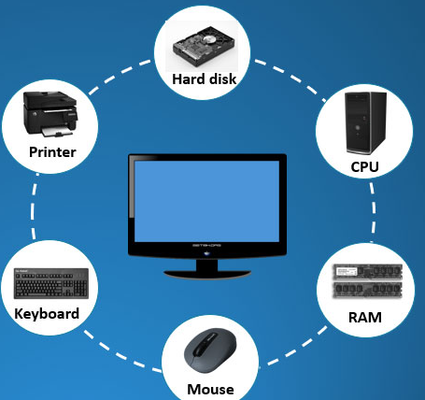
Computer Hardware components
What is computer hardware?
Computer hardware is a collective term used to describe any of the physical components of an analog or digital computer.
E.g.
CPU
RAM
Keyboard
Processor
Hard disk
Monitor
Mouse etc.…

Slide 4
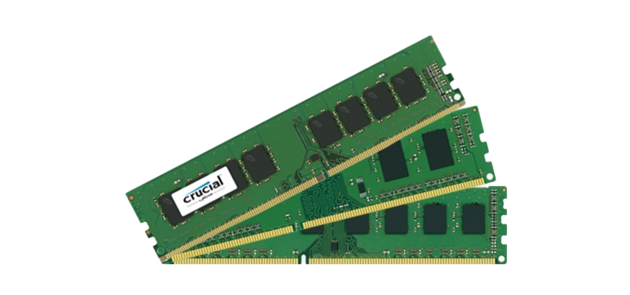
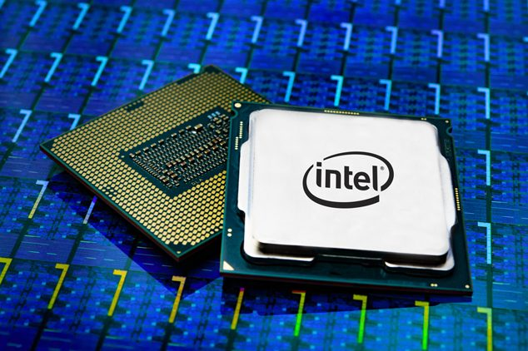
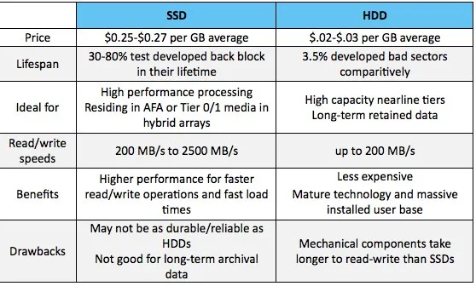
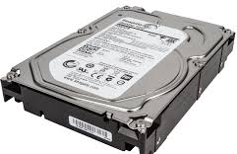
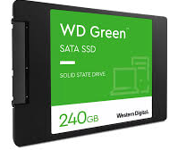
Computer Hardware components cont.…
RAM: (random access memory) is a hardware device that allows information to be stored and retrieved on a computer
Processor : A processor performs arithmetical, logical, input/output (I/O) and other basic instructions that are passed from an operating system (OS).
Hard Disk Drives: Hardisk is a storage which stores the documents/files and folders
Notes:
magnetic disks or platters rotating at high speeds Storage starts from 16,32,64, 500 GB,1 TB, 2 TB we can find more than 4 TB drives

Slide 5
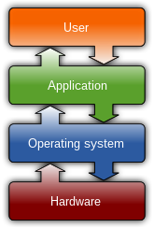
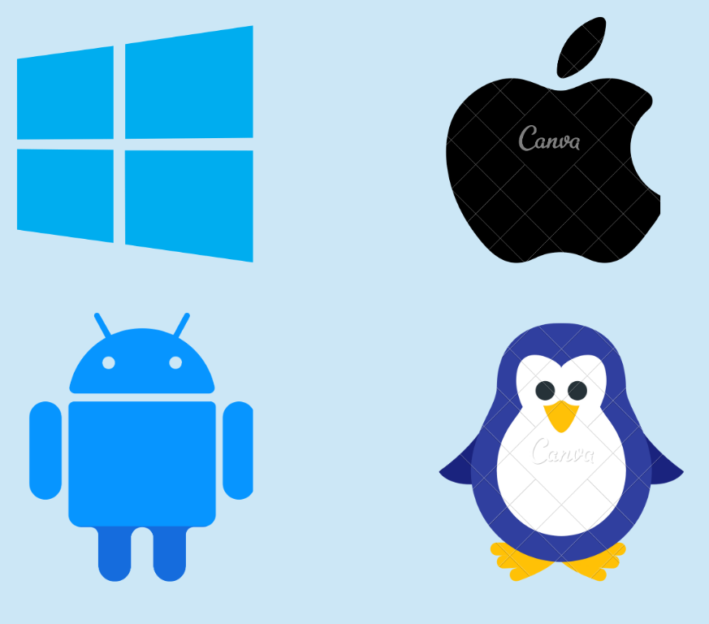
Operating System
An operating system (OS) is the program that, after being initially loaded into the computer by a boot program, manages all the other application programs in a computer
The four most common operating systems for personal computers are:
Microsoft Windows
Apple Mac OS X,
Linux.
Android
Note:
Server OS: Server operating systems are designed to provide services, resources, and data to other computers on a network.
Client OS:Client operating systems are designed for individual users or client devices.

Slide 6
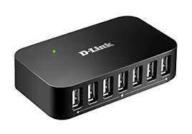
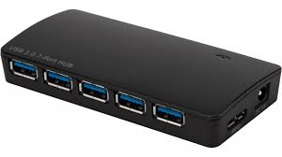
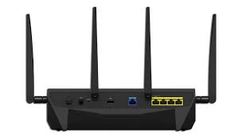
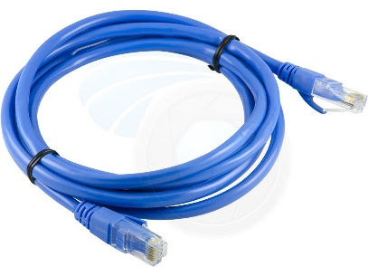
Introduction to Network
Introduction to Networking: Networking is the practice of linking two or more computing devices together for the purpose of sharing data
Networking Components:
HUB: Hub is a device that splits a network connection into multiple computers. It is like a distribution center
Switch: Switch is a telecommunication device grouped as one of computer network components.
Router: is a Device that used to connect a LAN with an Internet Connection
LAN Cable: A local area Network cable is also known as data cable or Ethernet cable which is a wired cable used to connect a device to the internet or to other devices like other computer, printers, etc.

Slide 7
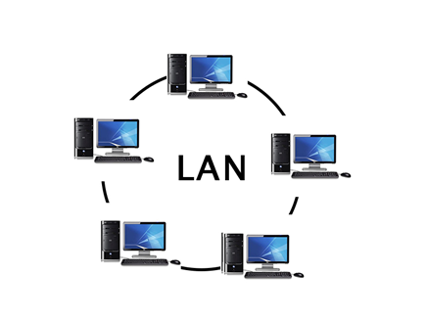
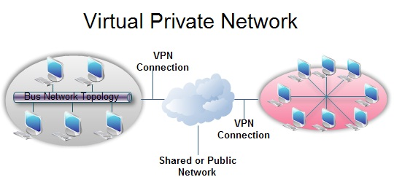
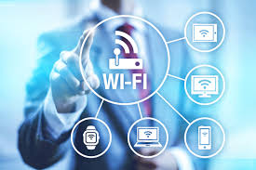
Introduction to Networking Cont…
LAN(Local Area Network):Local Area Network is a group of computers connected to each other in a small area such as building, office.
Virtual Private Network(VPN):A Virtual Private Network is a connection method used to add security and privacy to private and public networks
Wi-Fi is a wireless networking technology that allows devices such as computers (laptops and desktops), mobile devices (smart phones and wearables), and other equipment (printers and video cameras) to interface with the Internet

Slide 8

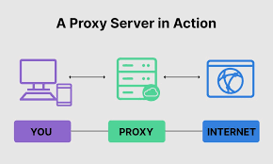
Network Securities
Network security is any activity designed to protect the usability and integrity of your network and data. It includes both hardware and software technologies
Proxy Server :A proxy server is a server that sits between a client application, such as a Web browser, and a real server.
Why a Proxy Server should be used ?
To control internet usage
Bandwidth savings and improved speeds
Privacy benefits
Improved security
Get access to blocked resources

Slide 9
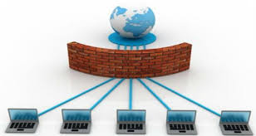
Network Securities cont…
Firewall: A firewall is a system designed to prevent unauthorized access to or from a private network
Why Firewalls used ?
Firewall Protects Computer From Unauthorized Remote Access
Firewalls Can Block Messages Linking to Unwanted Content
Firewalls Make Online Gaming Safer
You Can Block Unsuitable or Immoral Content With a Firewall
Firewalls Can Be Hardware or Software
E.G :
Hardware firewalls : Sonic Wall, Sophos, Cyberoam etc..
Software Firewalls: Windows Firewall, Comodo Free Firewall
Notes:
Firewall will impact during activation, re activation and other connectivity activities

Slide 10

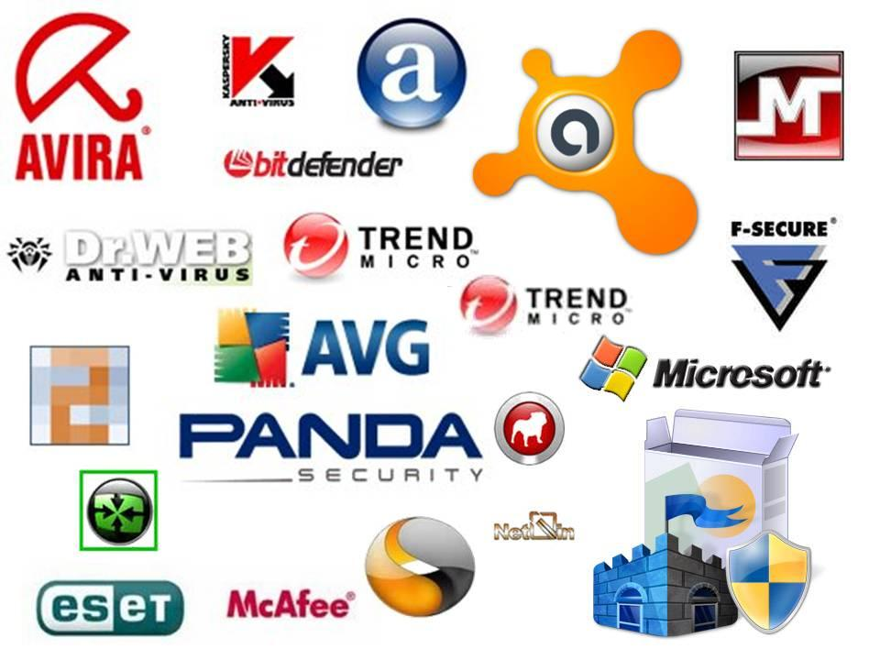
Network Securities cont..
Antivirus: Is a type of program designed and developed to protect computers from malware like viruses, computer worms, spyware etc..
Antivirus Performs following activities:
Virus Detection
System Analysis
Malware Removal
File Quarantine
Threat Identification
Online Security
Data Protection
Some of the lists of Antivirus Softwares

Slide 11
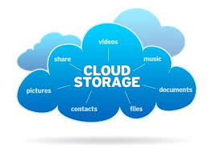
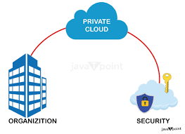
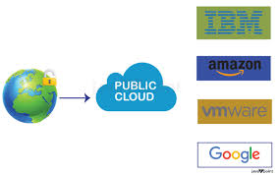
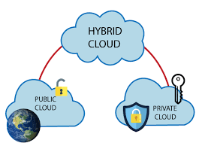
About Cloud
The cloud is a distributed collection of servers that host software and infrastructure, and it is accessed over the Internet.
Types of cloud:
Private Cloud : a cloud computing environment dedicated to a single organization
Public cloud offers scalable, on-demand resources to organizations via the internet, which are owned and managed by a third-party provider.
A hybrid cloud is a cloud computing environment that combines on-premises datacenters (private clouds) with public clouds to allow data and applications

Slide 12
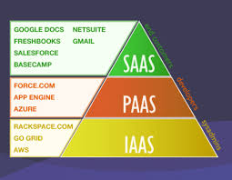
About cloud cont.…
There are the following three types of cloud service models -
Infrastructure as a Service: IaaS is also known as Hardware as a Service (HaaS). It is a computing infrastructure managed over the internet.
Platform as a Service PaaS cloud computing platform is created for the programmer to develop, test, run, and manage the applications.
Software as a Service :SaaS is also known as "on-demand software". It is a software in which the applications are hosted by a cloud service provider.

Slide 13
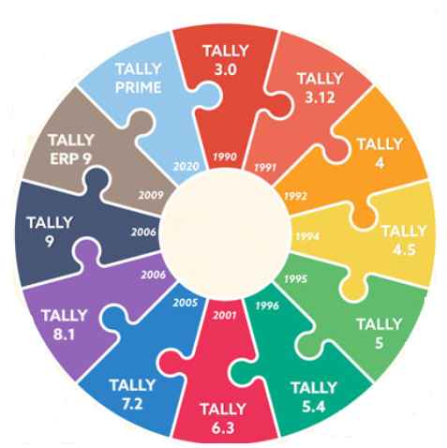
Tally Version History
Tally 3.0: 1990 with accounting features it’s DOS based version
Tally 5: First version compatible with Windows OS
Tally 5.4: This version was released in 1996. with import capability
Tally 4.5: 1994 minor enhancements supported
Tally 6.3 :2001 with ODBC and Data Sync
Tally 7.2-2005 with VAT and TDS and Service tax
Tally 8.1: 2006 with 13 Indian Multilingual Support
Tally 9.0 :2006 with additional Indian language support
Tally.ERP9:2009
Remote Access capability with support centre and control centre capability
TallyPrime:2020 with new user experience and simplified GST features

Slide 14
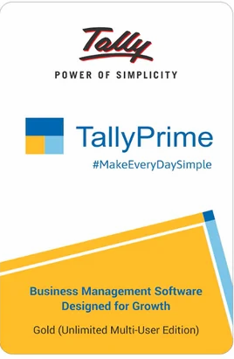
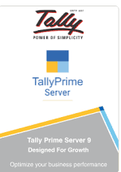
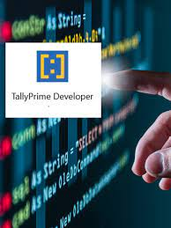
What are the Products?
TallyPrime is a Business Management software with features like Accounting, Inventory, Taxation,
TallyPrime Server: is a server-based data architecture that offers.
Concurrency
Reliability
Data Security
TallyPrime Developer is a development environment for Tally Definition Language (TDL), It allows TDL programmers to create and deploy solutions for TallyPrime.

Slide 15
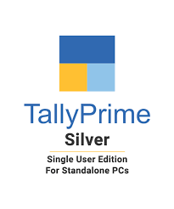
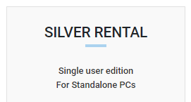
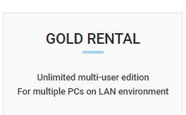
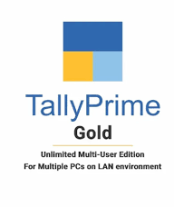
TallyPrime Product Flavors & License types
Perpetual License
Rental License

Slide 16
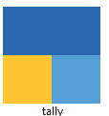
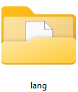

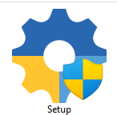

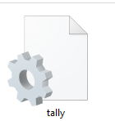
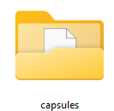


Components of TallyPrime
TallyPrime Application will help users to create and use various functionalities of Tally
This folder contains the language files which supports for using Tally in different languages
Tally Gateway Server is a license service file
This is a setup file i.e. with this the TallyPrime application will be installed
This is a license file which will create once after activating the license
This is a configuration file which stores all settings
This file stores all the changes and settings performed using TallyPrime
This folders contains feature update files especially banking feature
This file stores the ODBC configurations
This is the file which serves the license to node systems

Slide 17
TallyPrime Deployment Scenarios
One System
Multiuser (Local Area Network)
Hosting TallyPrime
Virtualized environment
On cloud

Slide 18
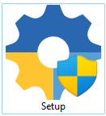
Product Walk through- Installation of TallyPrime
Installation Walk through
Single System & Multi System(Multiuser)

Slide 19
Other Deployment scenarios
Using TallyPrime Virtually
Thin Client
Using TallyPrime on Cloud
TallyPrime on AWS walk through
https://www.youtube.com/watch?v=ZxsOIh5CJvk

Slide 20
Product Walk through – Top Menu
F1 Help
Troubleshooting
Settings
What's New?
Upgrade experience
Tallyshop
Application
Event log
Repair/Reinstall Application
Language
Display Language
Data Entry language
Startup
Country Settings
Display
Connectivity
TallyAddons
About
Print
Share
Export
Import
Exchange
Data
Company

